Slide 1


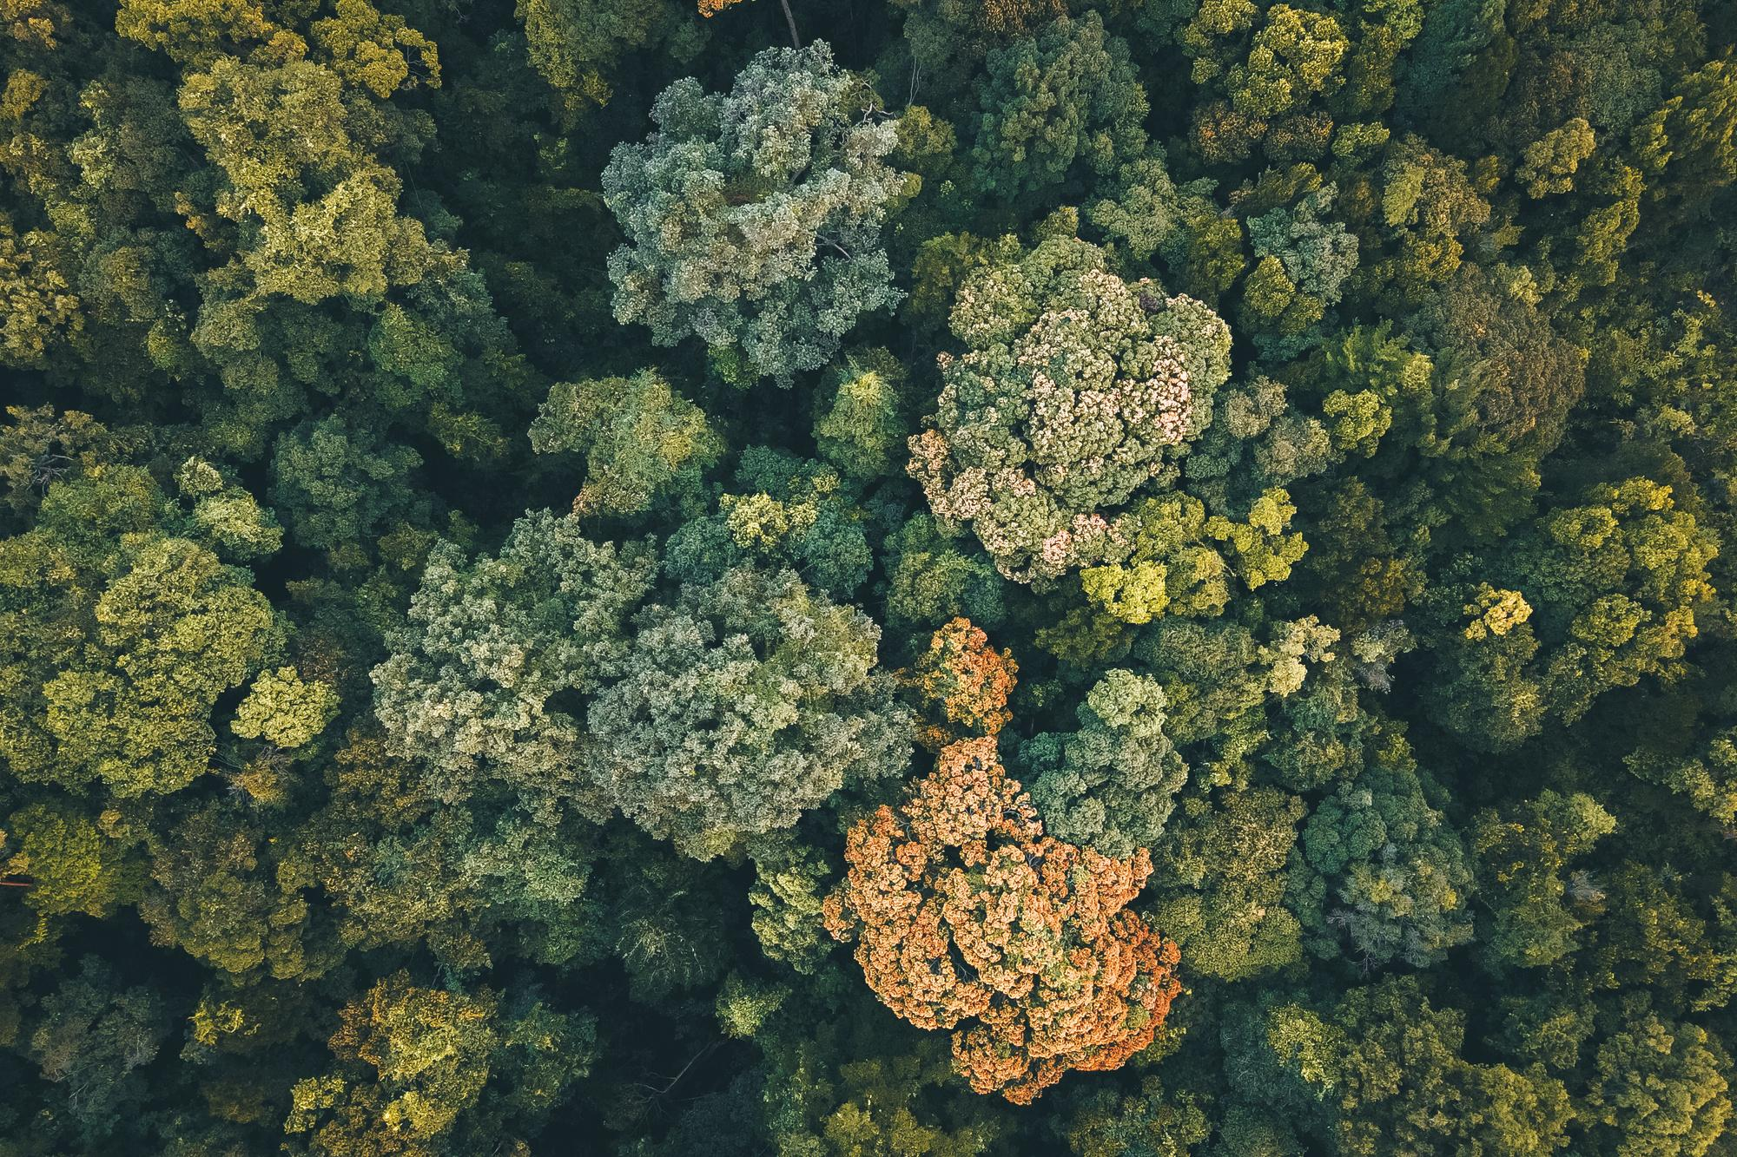
Deep Semantic Segmentation of Trees Using Multispectral Images
AUTHORS: IREM ULKU, ERDEM AKAGÜNDÜZ, PEDRAM GHAMISI

Slide 2
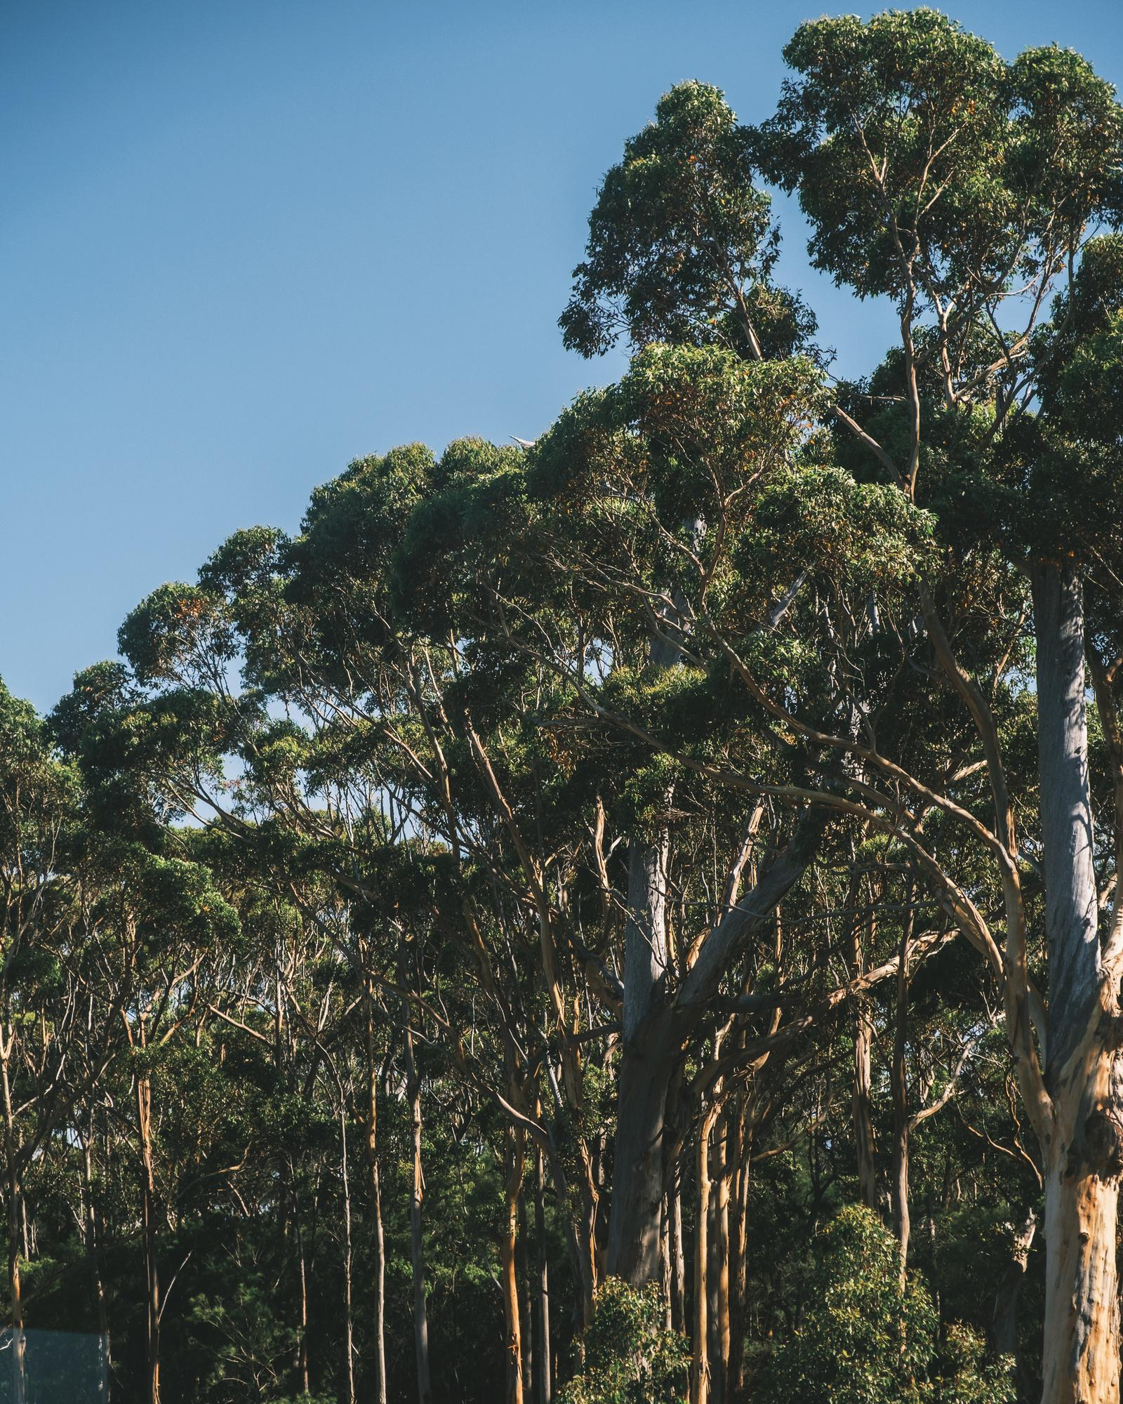
Introduction
Forests crucial for climate stability
Efficient monitoring through remote sensing
Role of deep learning in revolutionizing forest monitoring

Slide 3
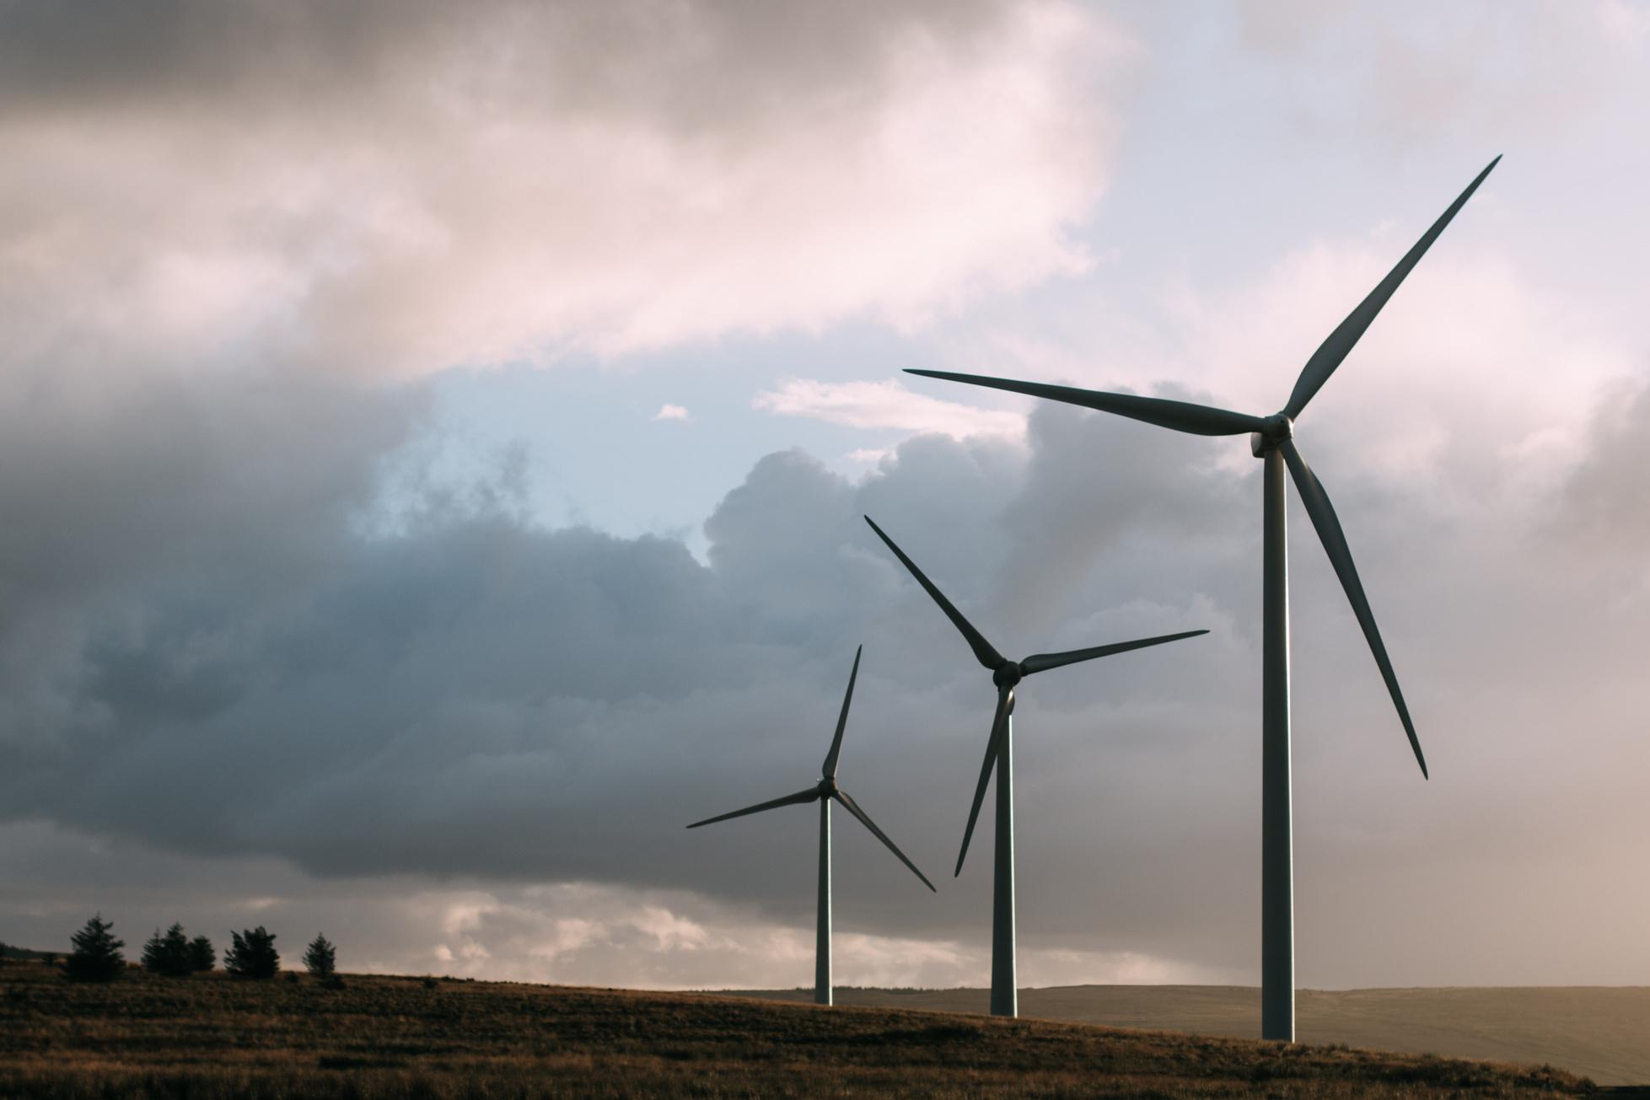
Motivation
Need for accurate and efficient forest cover monitoring
Shift from manual interpretation to AI-based methods

Slide 4


Contribution
Addressing challenges in tree segmentation
Introduction of deep learning for improved accuracy

Slide 5



Methodology
Large-scale experiments with multispectral imagery
Benchmarking deep semantic segmentation architectures
Exploration of hand-crafted spectral vegetation indices

Slide 6

Results
Experimental outcomes on DSTL and RIT-18 datasets
Comparison of deep learning models and traditional Random Forest

Slide 7
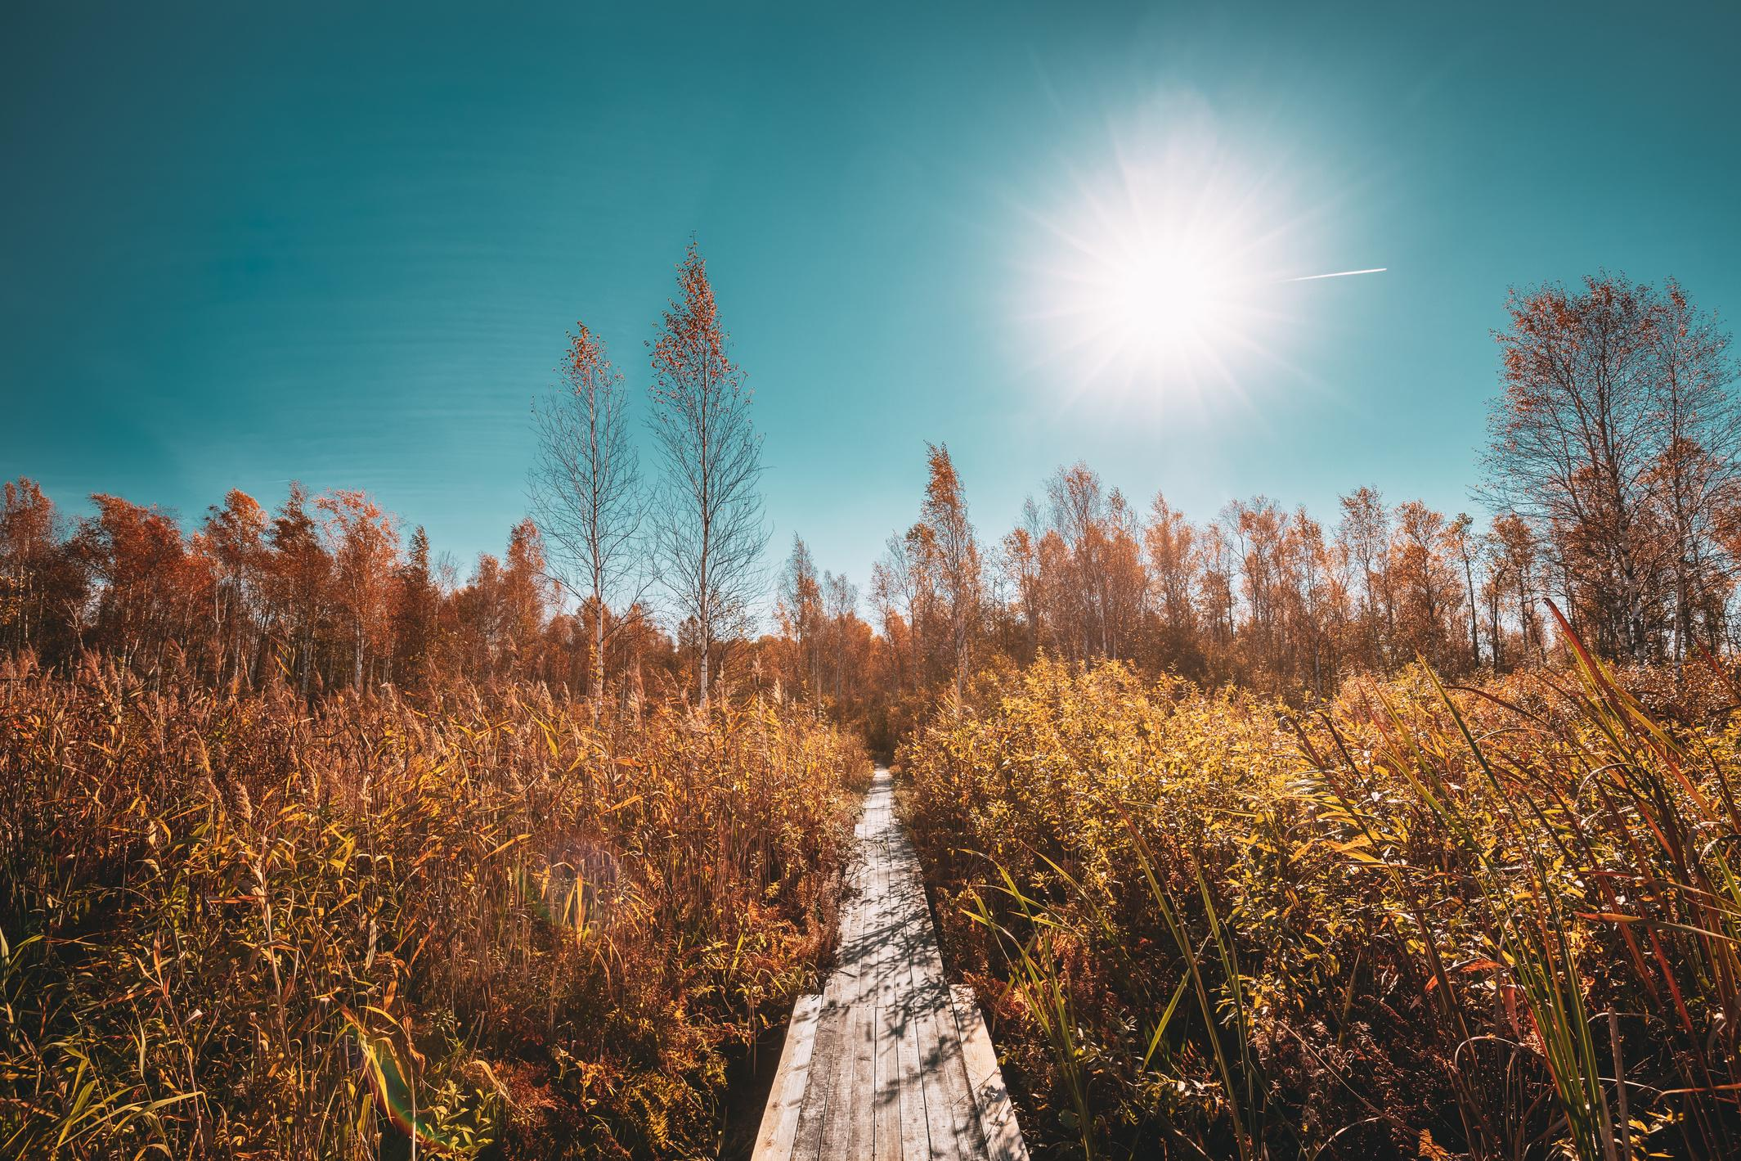
Limitations
Importance of high spatial resolution for accurate segmentation
Sensitivity of NIR reflectance in achieving precise results

Slide 8
Synthesis
Superiority of DLinkNet in handling occlusion and grassland
Advantage of combining diverse spectral bands for improved performance

Slide 9

Conclusions
Significance of spatial resolution in segmentation accuracy
Recommendation for domain-specific pretrained encoders

Slide 10
Future Directions
Focus on improving backbone architecture
Exploration of vision transformers for enhanced performance

Slide 11
Q&A
Open floor for questions and discussions
Feel free to adjust the content according to your preferences or add specific details that are important for your presentation.

